Slide 1

Food Delivery App Project
NMIMS – WX MBA Business Problem solving using Tableau
Jackie Hinduja

Slide 2

A food delivery app company's senior product manager has approached us (the consultants) for help in dentifying the root cause for lower order through rate percentage in Pune, which is 10% lower than the national average and other top cities. By reviewing metrics such as demand, menu to cart percentage, cart to order percentage, order through rate percentage, and average discount shown, we are tasked to find inferences and possible causes for the said issue
Executive Summary of the Business Problem

Slide 3
Hypotheses Formulation
Context | Customer | Company | Collaborator | Climate
1) The food delivery market in Pune is highly competitive, making customers less loyal to a specific app and more likely to switch to a competitor with better deals or service. | 1) Customers are reporting issues with food quality and order accuracy. Implementing quality control processes and verifying orders before delivery can reduce the number of such issues, resulting in higher customer satisfaction. | 1) The app's management and staff in Pune are not as effective or efficient in managing the app's operations, resulting in lower quality and reliability of services. Driver shortages are causing delivery delays. Offering incentives to attract more delivery partners can solve this problem and improve delivery times. | 1) Inadequate collaboration with local restaurants and delivery drivers is causing slower delivery times and lower food quality. Improving communication and collaboration with these stakeholders can improve delivery times and maintain food quality during delivery. | 1) The app's services in Pune are affected by seasonal factors such as extreme weather conditions or local festivals, resulting in lower demand or logistical challenges.
2) The app's marketing and promotional strategies in Pune are not as effective as in other regions, resulting in lower awareness and adoption of the app's services. | 2) Poor delivery routes are causing delays for customers in Pune. Incorporating optimal routes provided by the app can improve delivery times, leading to increased customer satisfaction. The app's services in Pune are not reliable or consistent in terms of delivery time or order accuracy, leading to lower user satisfaction and repeat business. | 2) The app's pricing and fee structure in Pune are not as competitive or attractive compared to other food delivery apps in the region, resulting in lower demand and usage. | 2) Unresponsive customer support is causing delivery partners difficulties in delivering orders on time. Improving customer support can ensure that delivery partners receive timely assistance, leading to improved delivery times. The app's delivery fleet in Pune is not as large or well-equipped to handle high volume or long distances, resulting in lower order fulfillment rates and user satisfaction. | 2) The app's services in Pune are affected by local regulatory or policy constraints, such as restrictions on delivery hours or routes, resulting in lower efficiency or quality of services.

Slide 4
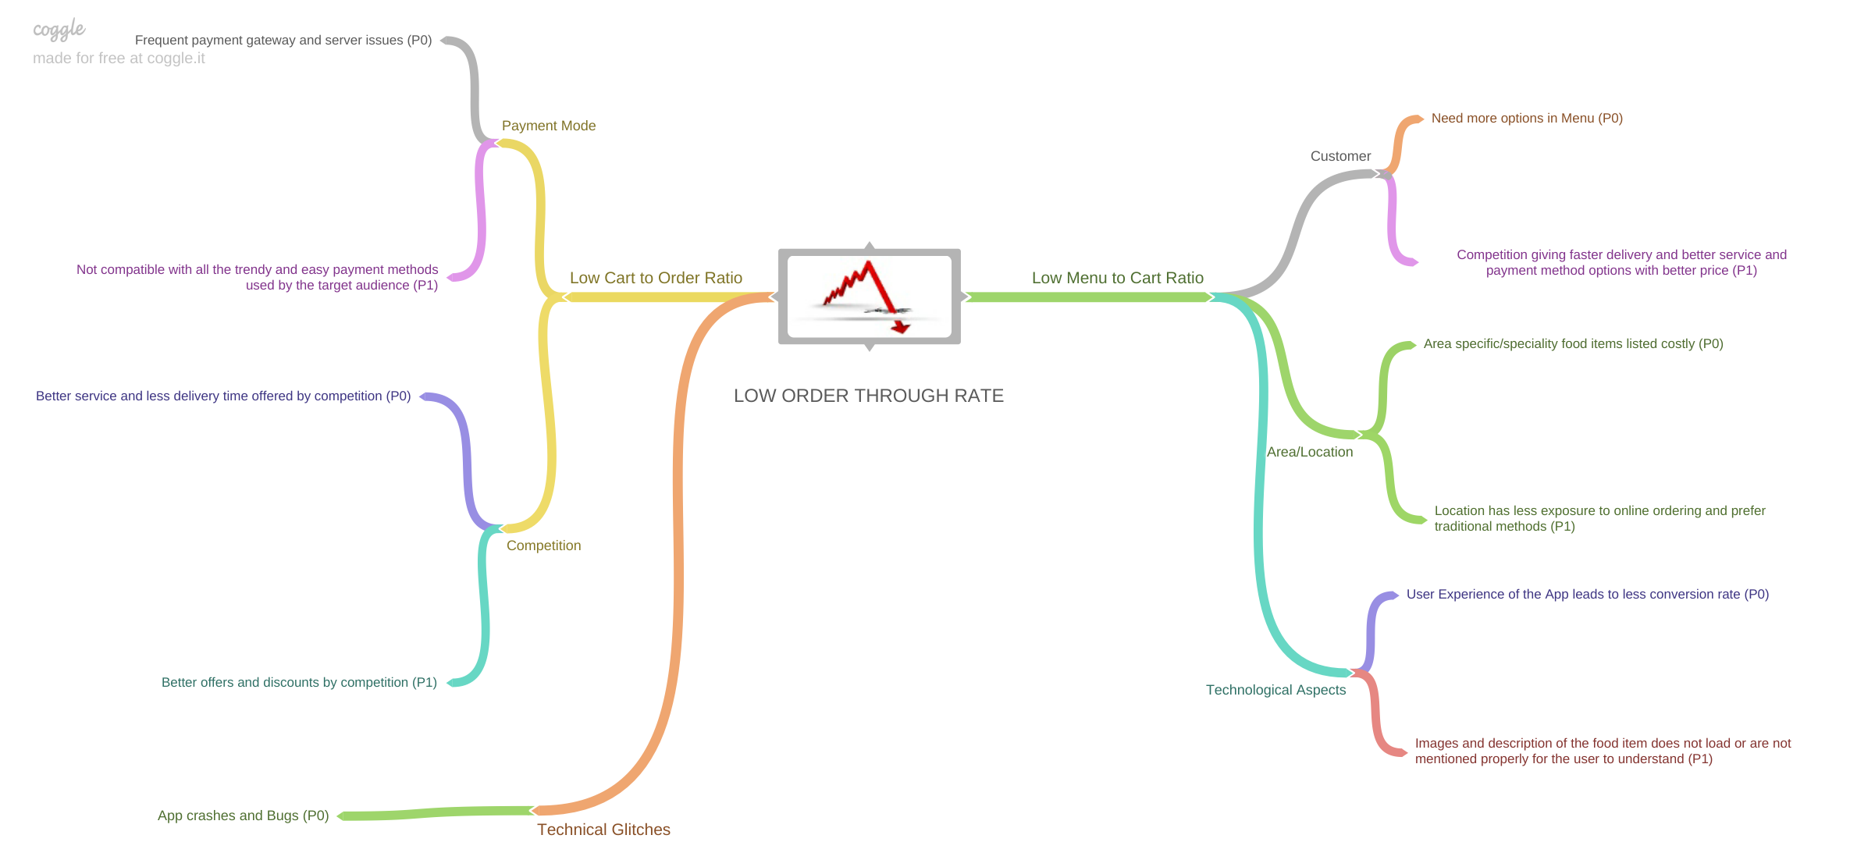
Issue Tree

Slide 5
The Root Cause and Findings!
We see that there is definitely an issue with the Pune city’s and there are various factors affecting the low performance of the food delivery app in the said city.
Time Frame / Range : We see that there are certain time frames wherein there are steep decline in orders at Pune city when compared to the rest of the cities.
Meal Type : This goes hand in hand with the time frame and range we talked in the earlier point, where in Late night snack and Early morning breakfast are the 2 major pain points for the app at Pune city, both these time frames have lowest order rate.
Menu to Cart Rate : People are surfing the app at certain time frames and yet are not going ahead with selecting items to be put in cart, this is certainly related to food types, area/zones which are in to be looked at.
Cart to Order Rate : The cart to order rate too seems worrying factor with Pune having the lowest cart to order rate and people are just not placing the order
Payment Mode : Cash on Delivery order at certain zones are also certain pain point to worry about.

Slide 6
Data and Visualizations
Note : Each visualization has its comment/inferences attached in the screenshot itself for better use of inbuilt comment feature of Tableau

Slide 7
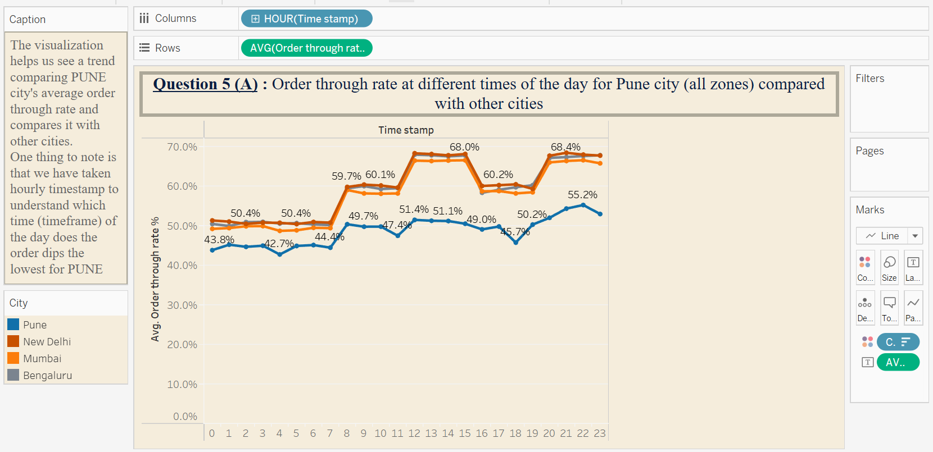

Slide 8
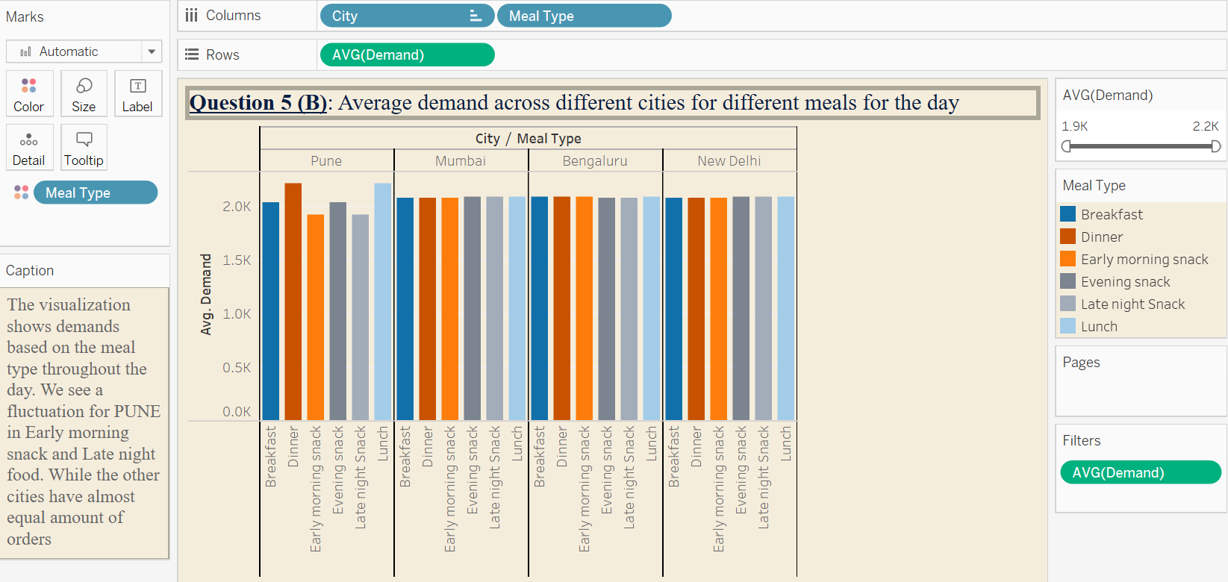

Slide 9
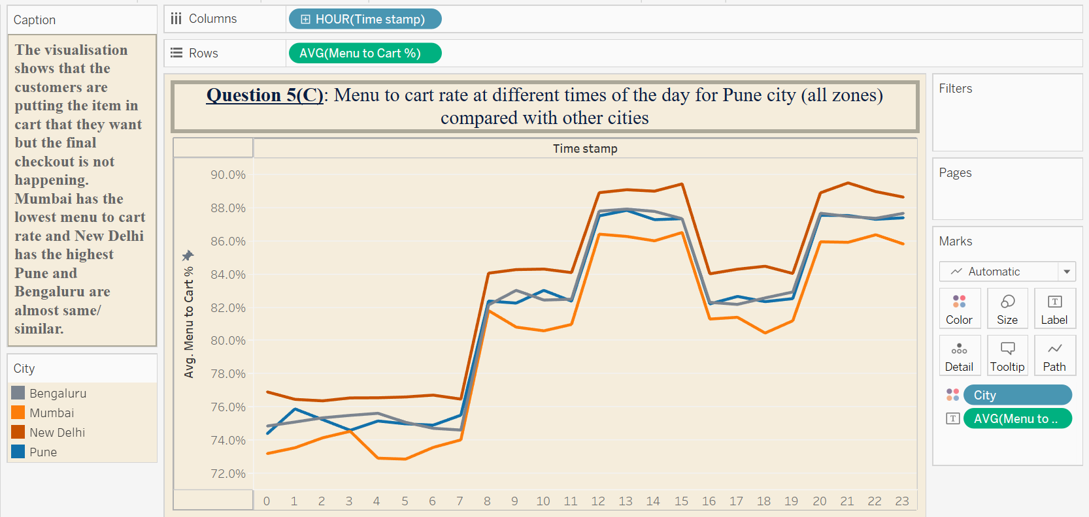

Slide 10
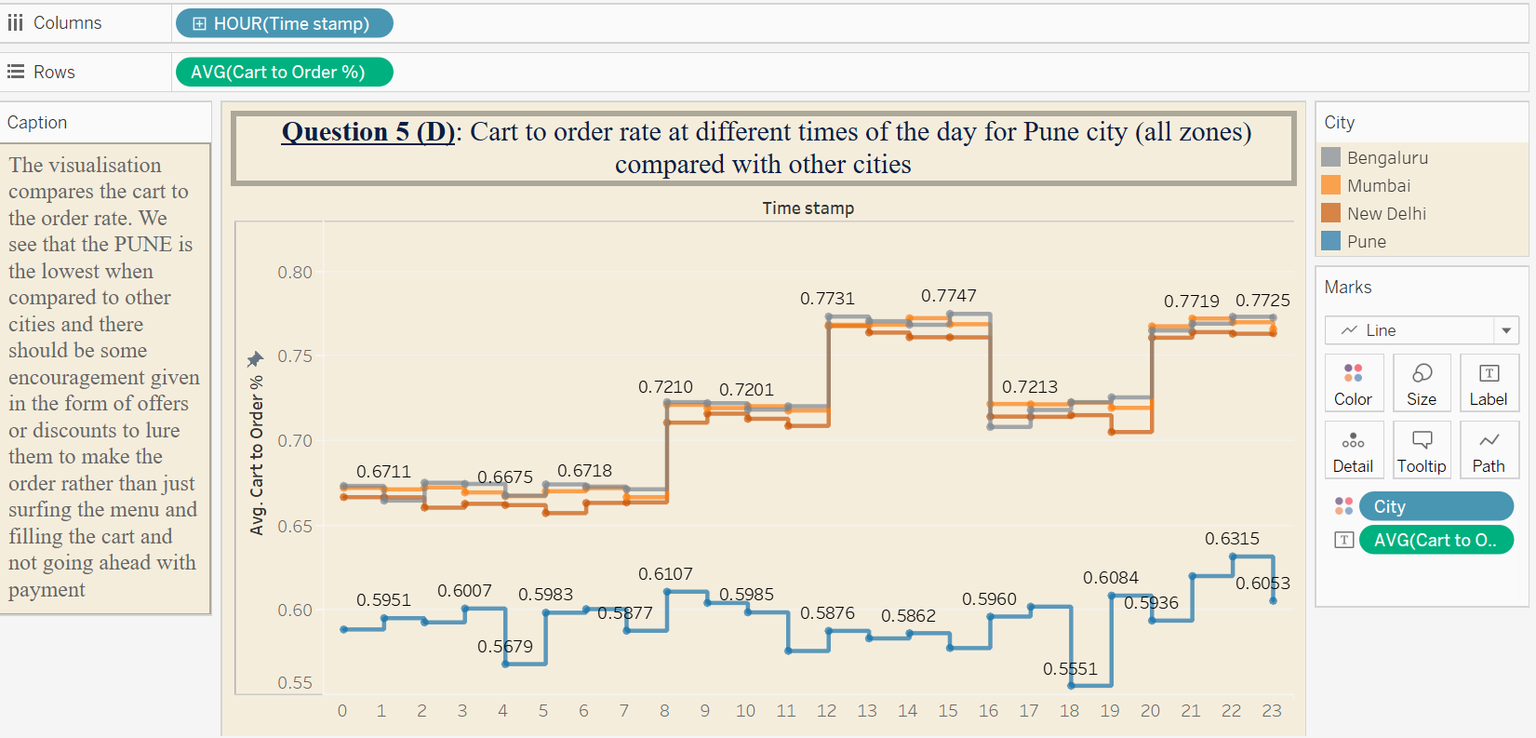

Slide 11
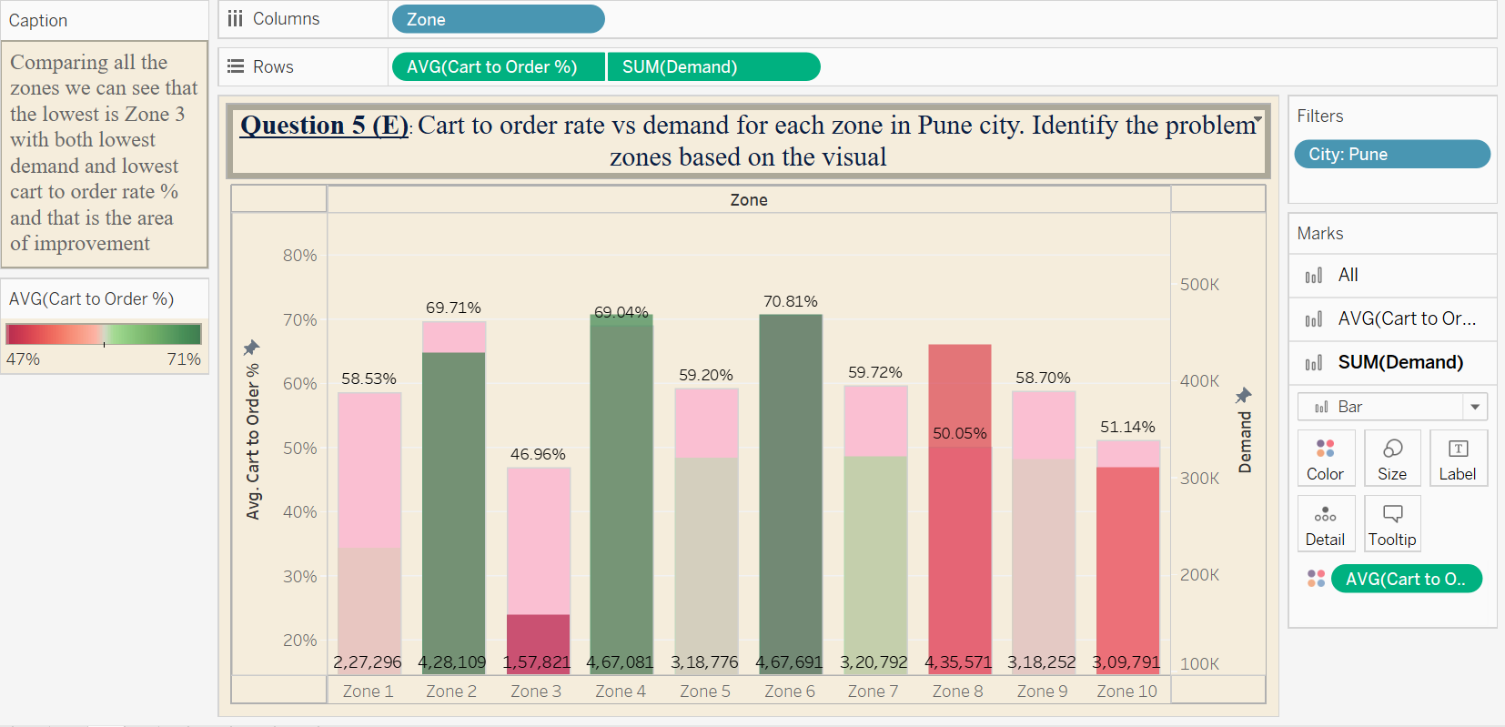

Slide 12
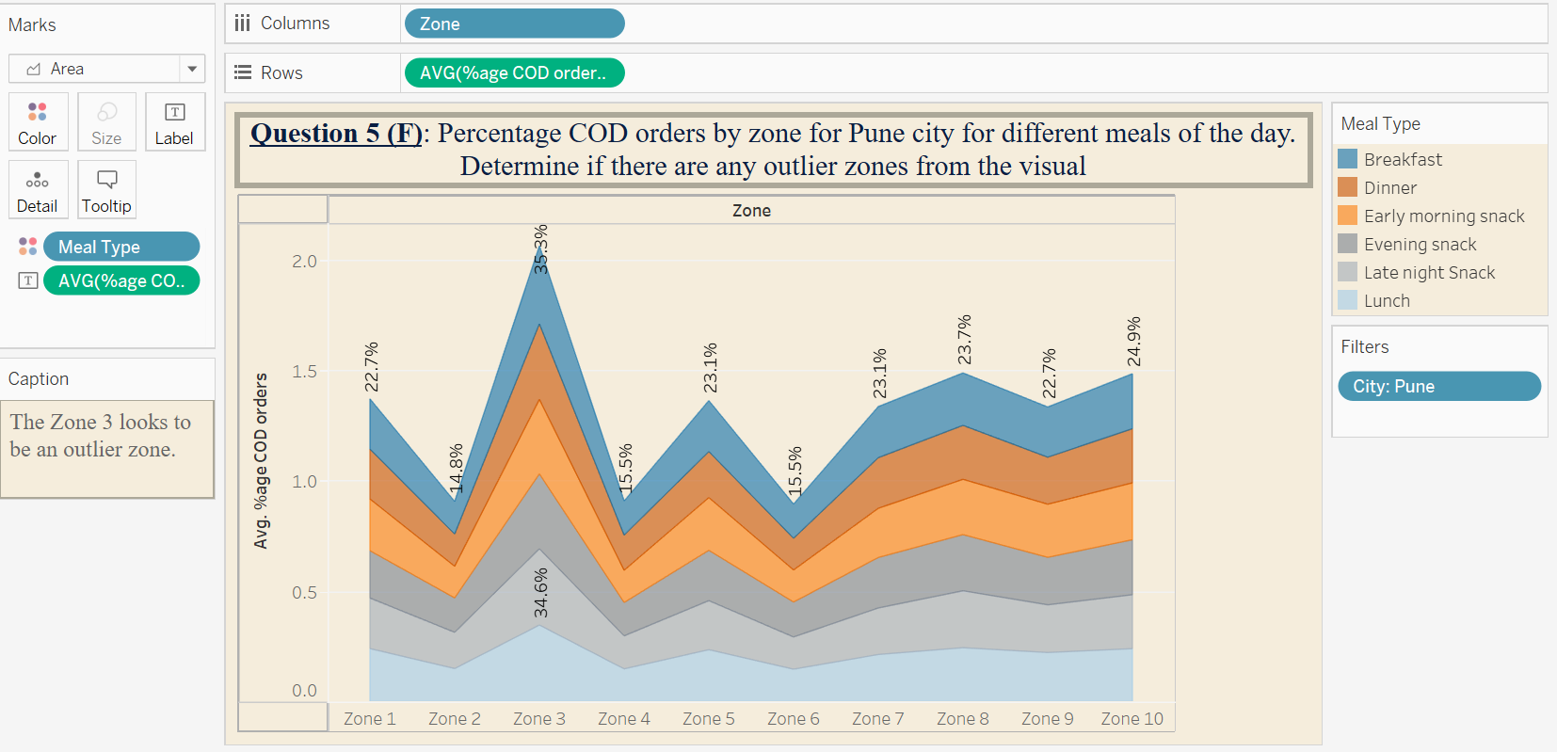

Slide 13
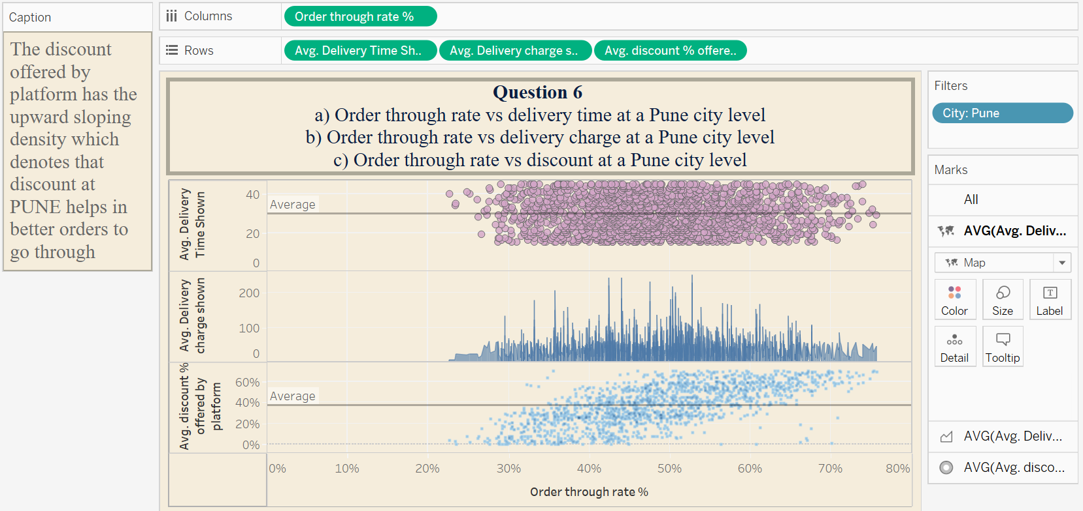

Slide 14

Recommendations
The management of the food delivery app needs to:
Target the time frames and focus on possible pain points of the customer to find out why they are not converting menu to cart.
The possible issues can be the competitor is offering better price, or less delivery charges at faster delivery time.
The Zones such as Zone 3 of Pune can be looked upon further to target them even better
Offers and discounts seems to be a good way to lure the customers to order, we can push in offer/discount notifications at the breakfast and late night snack time which are the lowest order rate for Pune.
All these aspects can together solve the issue prevailing to the drastic dip in performance for Pune area.
Possible solutions to work upon to see better results.

Slide 15

Feedback ?

